Slide 1



IMDB Top Movies_Kamal
View in Power BI
Last data refresh:
11/25/2021 9:38:58 AM UTC
Downloaded at:
1/17/2022 12:11:13 PM UTC

Slide 2
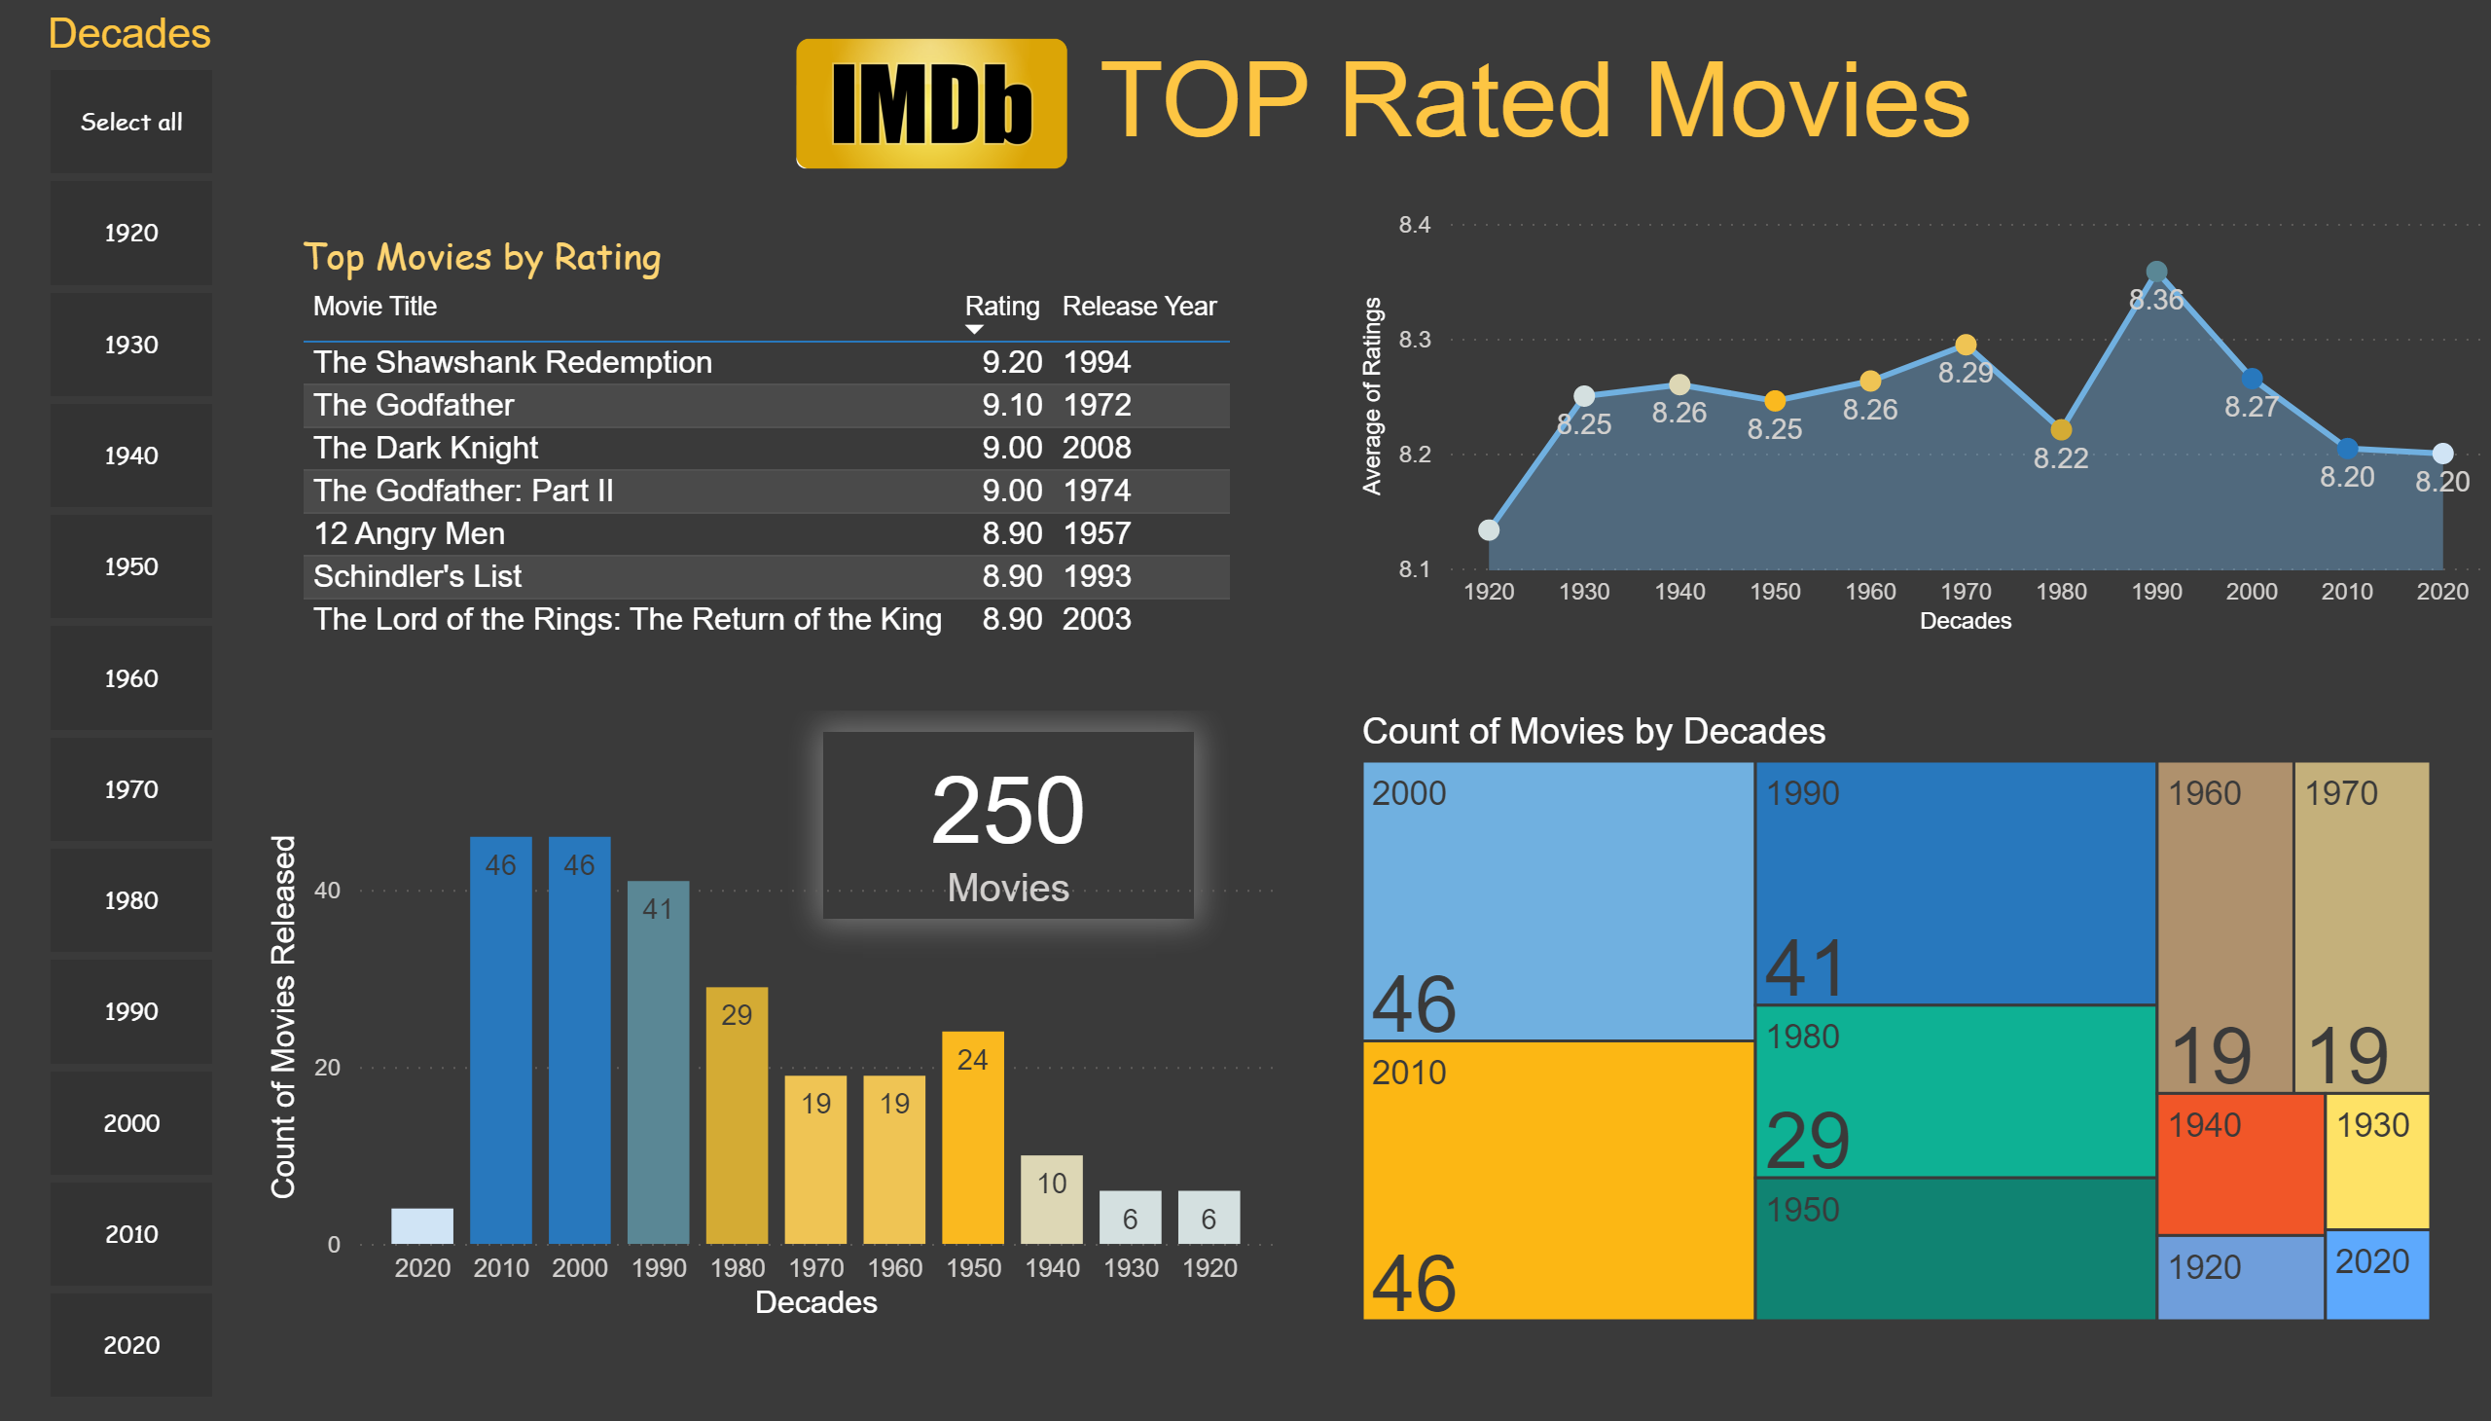
Top IMDB Rated Movies
Notes:
Count of Movies by Decades
No alt text provided
Top Movies by Rating
No alt text provided
card
No alt text provided
Count of Movies by Decades
No alt text provided
stackedAreaChart
No alt text provided
image
No alt text provided
textbox
No alt text provided
Decades
No alt text provided

